Slide 1

Fr. Conceicao Rodrigues Institute of Technology, Vashi
Department of Electronics and Telecommunication Engineering
Smart Weather Station
Group no: (14)
Prathamesh Shedale 3021149
Kartik Sonawane 3021152
Vedant Thakur 3021154
Vivek Todkar 3021155
Under the guidance of
Mrs. Manita rajput

Slide 2
Problem Statement :-
Weather conditions significantly impact aviation and maritime operations.Smart weather stations provide pilots, ship captains, and port authorities with real-time weather updates, helping them make informed decisions about flight routes, navigation, and port operations. Smart weather stations play a crucial role emergency preparedness and response. They provide timely weather alerts and forecasts to emergency management agencies, enabling them to issue warnings, coordinate response efforts, and mitigate the impact of severe weather events

Slide 3
PROJECT OBJECTIVES:
Sensor Integration: Integrate temperature, humidity, air pressure, wind speed, and precipitation sensors with the STM32 microcontroller to ac curately measure and monitor weather parameters.
Data Acquisition: Develop software to acquire data from the sensors at regular intervals, ensuring reliable and accurate measurements. Implement filtering and calibration techniques to enhance data accuracy
User Interface: Design a user-friendly interface to display real-time weather data, including temperature, humidity, wind speed, and other relevant
parameters. Provide graphical representations and historical data for analysis
and comparison.
Weather Forecasting: Develop algorithms to analyze the collected weather data and generate accurate short-term and long-term weather forecasts Utilize historical data and statistical techniques to improve the accuracy of the forecasts.
Connectivity: Enable connectivity options such as Wi-Fi or Ethernet to transmit weather data to external devices or cloud services for remote monitoring and analysis. Ensure secure data transmission and compatibility with standard protocols.
System Integration: Integrate all the components and subsystems of the smart weather station, ensuring seamless communication and functionality between the sensors, microcontroller, user interface, forecasting module, alert system, and connectivity options.

Slide 4
COMPONENTS:-
STM 32
DHT11 Sensor
MQ-135 Sensor
BMP-280 Sensor
Wifi 8266 Node MCU Module
Simulation :- Proteus

Slide 5
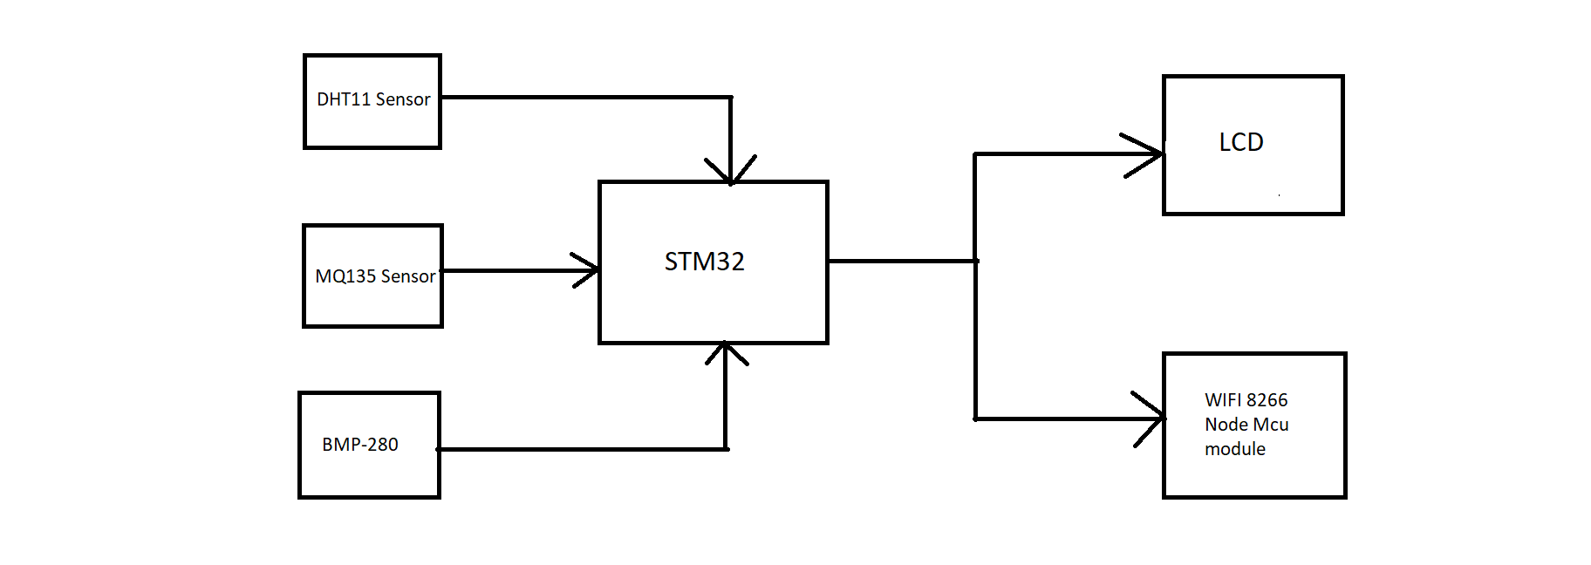
BLOCK DIAGRAM :-
MQ-135

Slide 6
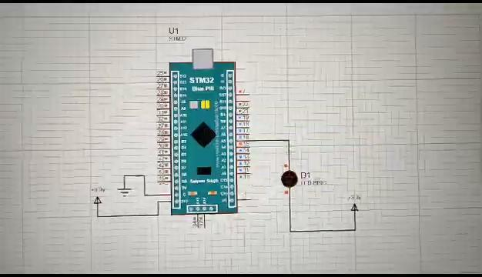
SIMULATION RESULT :-

Slide 7
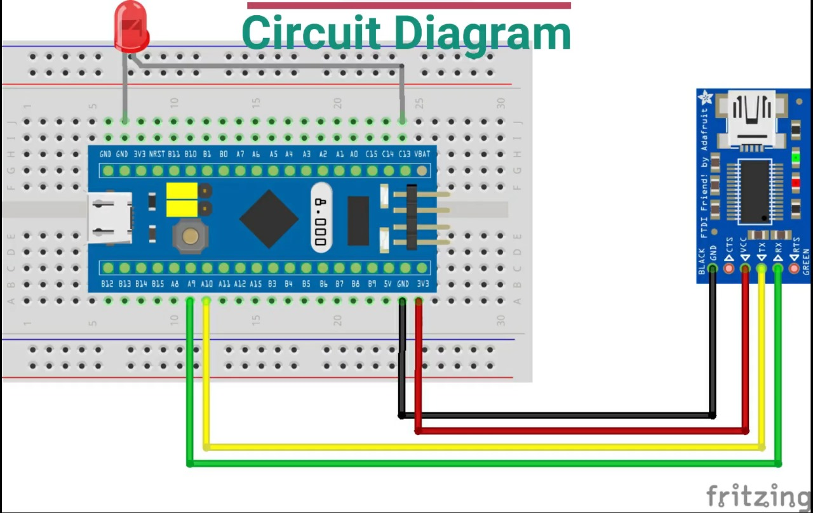
CIRCUIT DIAGRAM:-

Slide 8
SIMULATION CODE :-
#include "main.h"
void SystemClock_Config(void);
static void MX_GPIO_Init(void);
int main(void)
{ HAL_Init();
SystemClock_Config();
MX_GPIO_Init();
while (1)
{ // Turn on the LED
HAL_GPIO_WritePin(GPIOA, GPIO_PIN_5, GPIO_PIN_SET);
HAL_Delay(500); // Delay 500ms
// Turn off the LED
HAL_GPIO_WritePin(GPIOA, GPIO_PIN_5, GPIO_PIN_RESET);
HAL_Delay(500); // Delay 500ms }}
void SystemClock_Config(void)
{ RCC_OscInitTypeDef RCC_OscInitStruct = {0};
RCC_ClkInitTypeDef RCC_ClkInitStruct = {0};
HAL_RCC_PWR_CLK_ENABLE();
HAL_PWR_VOLTAGESCALING_CONFIG(PWR_REGULATOR_VOLTAGE_SCALE1);
RCC_OscInitStruct.OscillatorType = RCC_OSCILLATORTYPE_HSI;
RCC_OscInitStruct.HSIState = RCC_HSI_ON;
RCC_OscInitStruct.HSICalibrationValue = RCC_HSICALIBRATION_DEFAULT;
RCC_OscInitStruct.PLL.PLLState = RCC_PLL_NONE;
if (HAL_RCC_OscConfig(&RCC_OscInitStruct) != HAL_OK)
{Error_Handler();}
RCC_ClkInitStruct.ClockType = RCC_CLOCKTYPE_HCLK | RCC_CLOCKTYPE_SYSCLK | RCC_CLOCKTYPE_PCLK1 | RCC_CLOCKTYPE_PCLK2;
RCC_ClkInitStruct.SYSCLKSource = RCC_SYSCLKSOURCE_HSI;
RCC_ClkInitStruct.AHBCLKDivider = RCC_SYSCLK_DIV1;
RCC_ClkInitStruct.APB1CLKDivider = RCC_HCLK_DIV1;
RCC_ClkInitStruct.APB2CLKDivider = RCC_HCLK_DIV1;
if (HAL_RCC_ClockConfig(&RCC_ClkInitStruct, FLASH_LATENCY_0) != HAL_OK)
{ Error_Handler();}}
static void
MX_GPIO_Init(void)
{GPIO_InitTypeDef GPIO_InitStruct = {0};
/* GPIO Ports Clock Enable /
__HAL_RCC_GPIOA_CLK_ENABLE();
/Configure GPIO pin Output Level /
HAL_GPIO_WritePin(GPIOA, GPIO_PIN_5, GPIO_PIN_RESET);
/Configure GPIO pin : PA5 */
GPIO_InitStruct.Pin = GPIO_PIN_5;
GPIO_InitStruct.Mode = GPIO_MODE_OUTPUT_PP;
GPIO_InitStruct.Speed = GPIO_SPEED_FREQ_LOW;
HAL_GPIO_Init(GPIOA, &GPIO_InitStruct);
}

Slide 9
HARDWARE VIDEO:-

Slide 10
PROGRESS REPORT :- (TILL DATE )
MAKING ABSTRACT
BLOCK DIAGRAM
COMPONENTS SELECTION
SIMULATION
HARDWARE IMPLEMENTATION
CODE FOR ALL SENSORS

Slide 11
WORK PLAN AHEAD :-
Assemble all the required Hardware parts.
Start Working on the hardware part of the project.
Configure Stm32.
Working on the final hardware.

Slide 12
CONTRIBUTION :-
Prathamesh Shedale :- PPT,Simulation,Abstract,Deciding the hardware,hardware implementation
Kartik Sonawane :- PPT,Simulation,Abstract,Deciding the hardware,hardware implementation
Vedant Thakur :-PPT,Simulation,Abstract,Deciding the hardware,hardware implementation.
Vivek Todkar :-PPT,Simulation,Abstract,Deciding the hardware,hardware implementation.

Slide 13
REFRENCE :-
https://www.researchgate.net/deref/https%3A%2F%2Farxiv.org%2Fpdf%2F1802.02041.pdf
https://doi.org/10.2298/FUEE1902195D
https://ieeexplore.ieee.org/document/9182769
https://ieeexplore.ieee.org/document/9725697

Slide 14
Thank You

